Slide 1


APACHE SPARK DEEP DIVE ---Avoid GroupBy in Spark---

Slide 2
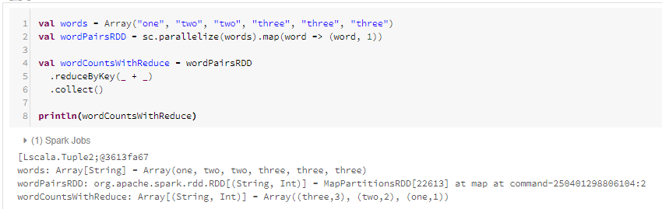

Avoid Group By
Understand it with an example of Word count- using GroupBy and ReduceBy
Using ReduceBy

Slide 3
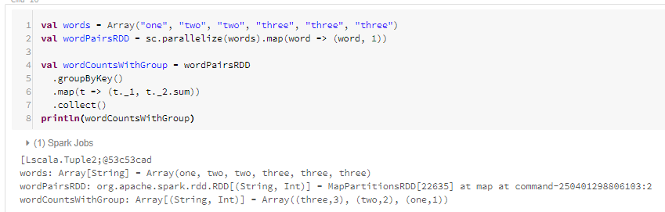

Avoid GroupBy
Using GroupBy

Slide 4
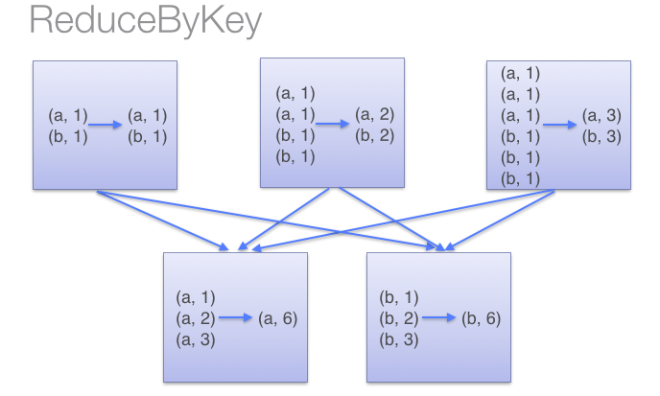

Avoid GroupBy
Now, Lets understand how reduceByKey works , pairs on the same machine with the same key are combined (by using the lamdba function passed into reduceByKey) before the data is shuffled. Then the lamdba function is called again to reduce all the values from each partition to produce one final result.

Slide 5
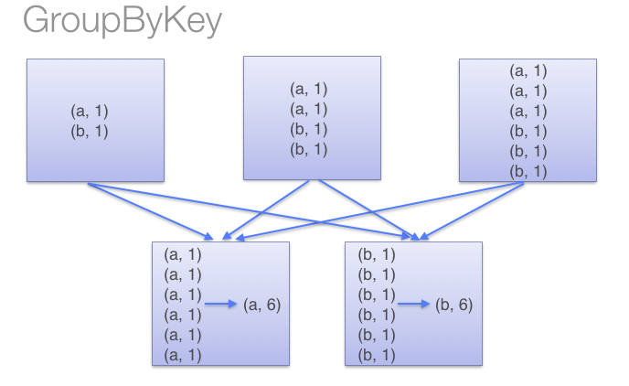

All the key-value pairs are shuffled around, unnecessary data to being transferred over the network
To determine which node to shuffle a pair to, Spark calls a partitioning function on the key of the pair, which is expensive.
In case of data spills to disk, data during shuffle not fitting into the executor memory, groupBy function flushes out the data to disk one key at a time, that’s the problem, makes the whole thing extremely slow.
Also, if a single key has more/huge key-value pairs than cannot fit in memory, an out of memory exception occurs.

Slide 6
Avoid GroupBy
Thanks and do subscribe to my channel

